Slide 1
Babblemouth
By- TEAM 420
Special Thanks to Pratham’s school friend – Aditya Gupta

Slide 2
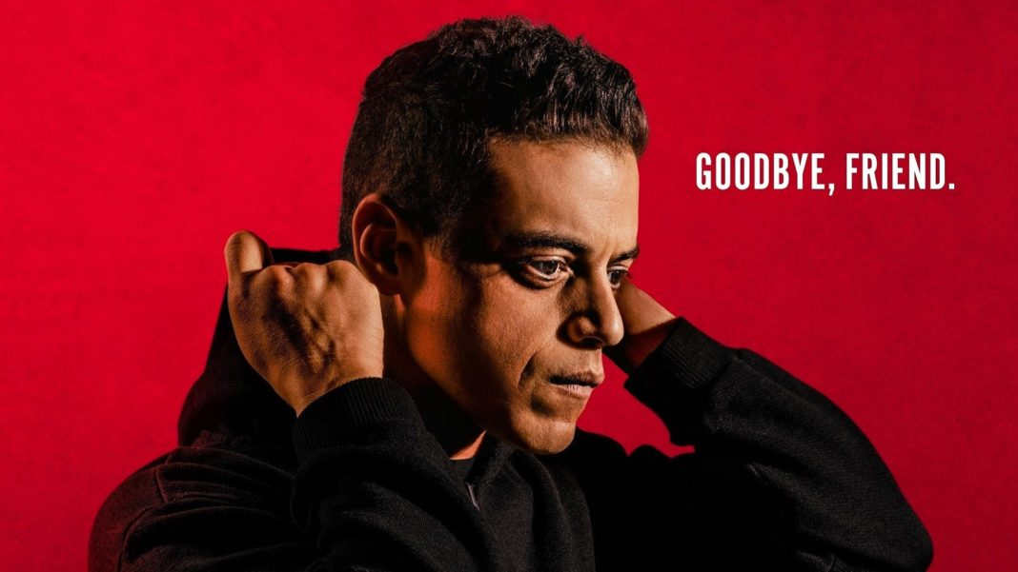


What Inspired us (Basically me 😅)

Slide 3
What it does
So we started out with an Encryption Program- Caesar Cipher, Modified Caesar Cipher, and Bifid Cipher.
But to include this Interesting piece of code into something Grand
So we made a BASIC Version of WhatsApp that runs on Terminal.

Slide 4
How we built it
We used .txt, .csv files for Data Storage
os module for opening the appropriate files
Tkinter module for GUI and so that everything isn’t just typing and lines 😅
Understanding How encryption works in REAL LIFE and where

Slide 5
Challenges we faced
We couldn’t make a Web application so that both users could be on different systems.
Decryption (I actually forgot what I did 😅)

Slide 6
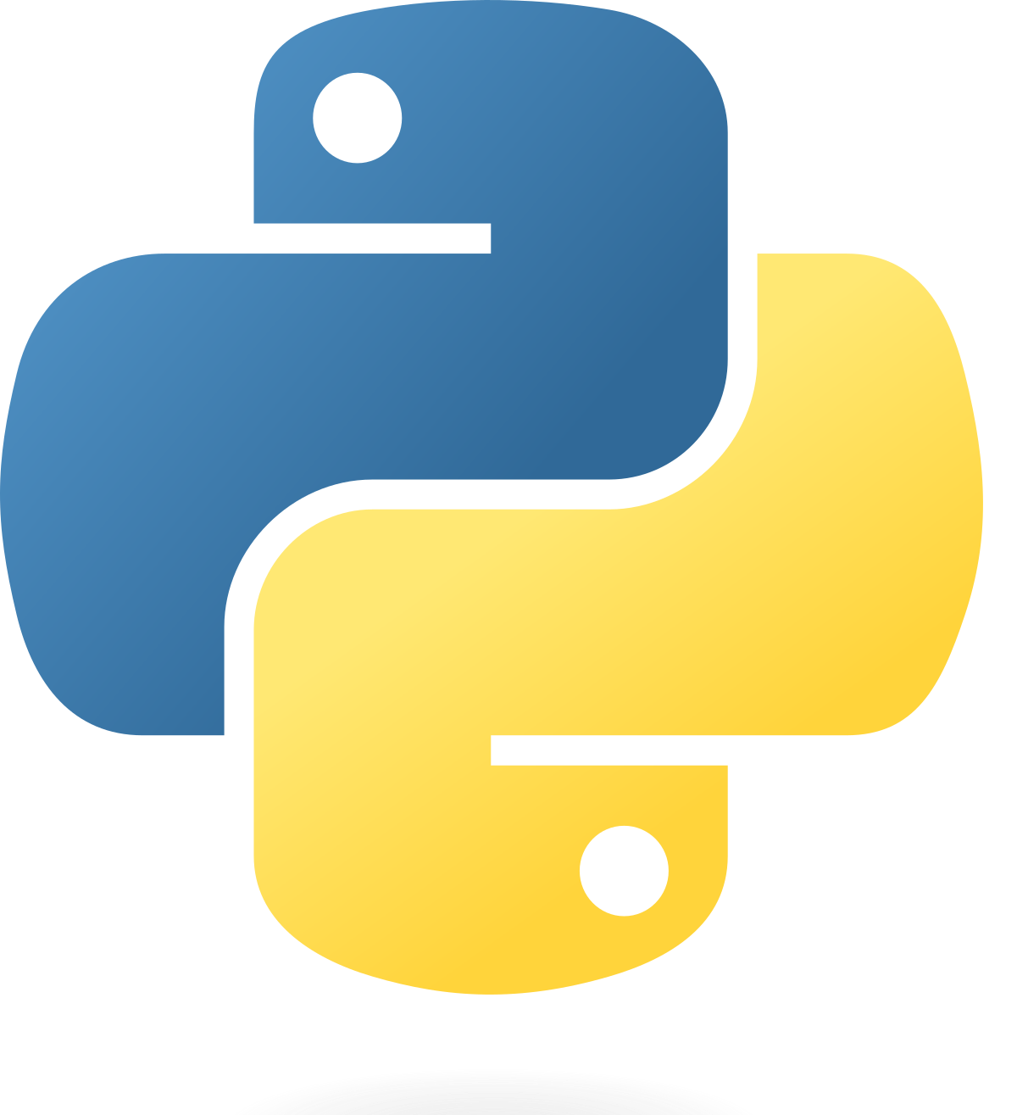
What we learnt
Basic Python
Basic Flask
Encryption Techniques
This Photo by Unknown Author is licensed under CC BY-SA

Slide 7
What’s next ?
Convert this idea into a Web Application

Slide 8


